Slide 1
Under no circumstances may these images or videos be used for anything other than educational purposes. If you want to use these images or videos for any purposes other than educational purposes, please follow the steps outlined on this website: https://support.ebird.org/en/support/solutions/articles/48001064551-requesting-and-downloading-media.
These teaching slides were adapted from the Cornell Lab K-12 Education team. Video and photo credits are listed below each one. We invite you to use these slides with your students in the classroom. You may edit this file, but please do not distribute the original or edited versions beyond your classroom. Simply refer your friends and colleagues back to this document.
Other classroom resources developed by the Cornell Lab K-12 Education team can be found at: https://www.birds.cornell.edu/k12/get-started/ and https://www.birds.cornell.edu/k12/science-nature-activities-for-cooped-up-kids/
If you have questions about this PowerPoint or how you can use it for educational purposes only, please email Pamela_Toschik@fws.gov.
Notes:
Species Name © Contributor’s Name; Cornell Lab of Ornithology | Macaulay Library OR
Species Name by Contributor’s Name; Cornell Lab of Ornithology | Macaulay Library
Another way to give access to teachers to videos if PowerPoint is problematic for them, would be to embed them in the website, which you can find instructions at the bottom of this page https://support.ebird.org/en/support/solutions/articles/48001064570-crediting-media (you’ll see that the info on crediting assets is outdated & I’ve let someone know this).

Slide 2
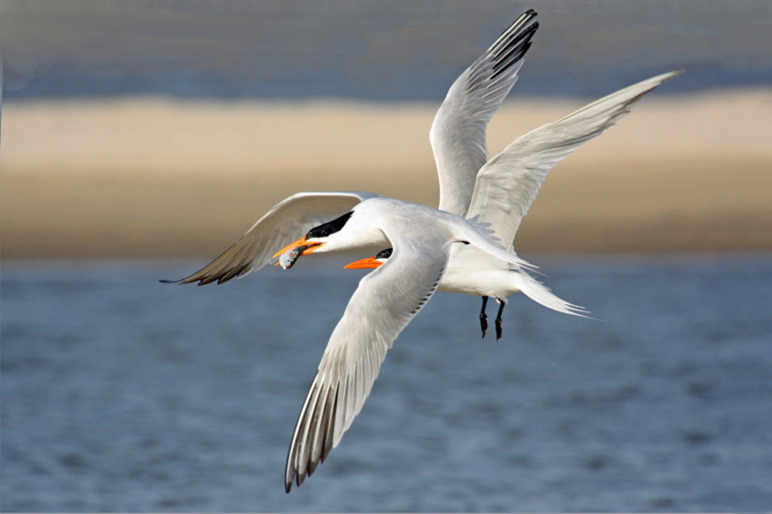

Flight,
Migration, & Collision Prevention
Pam Toschik, U.S. Fish and Wildlife Service, adapted from:
Royal Terns © Pat Comas, FeederWatch
Notes:
- start with a conversation about the article the class read –
- what did they learn?
- we are going to talk a little more about flight, migration and saving birds from window collisions

Slide 3

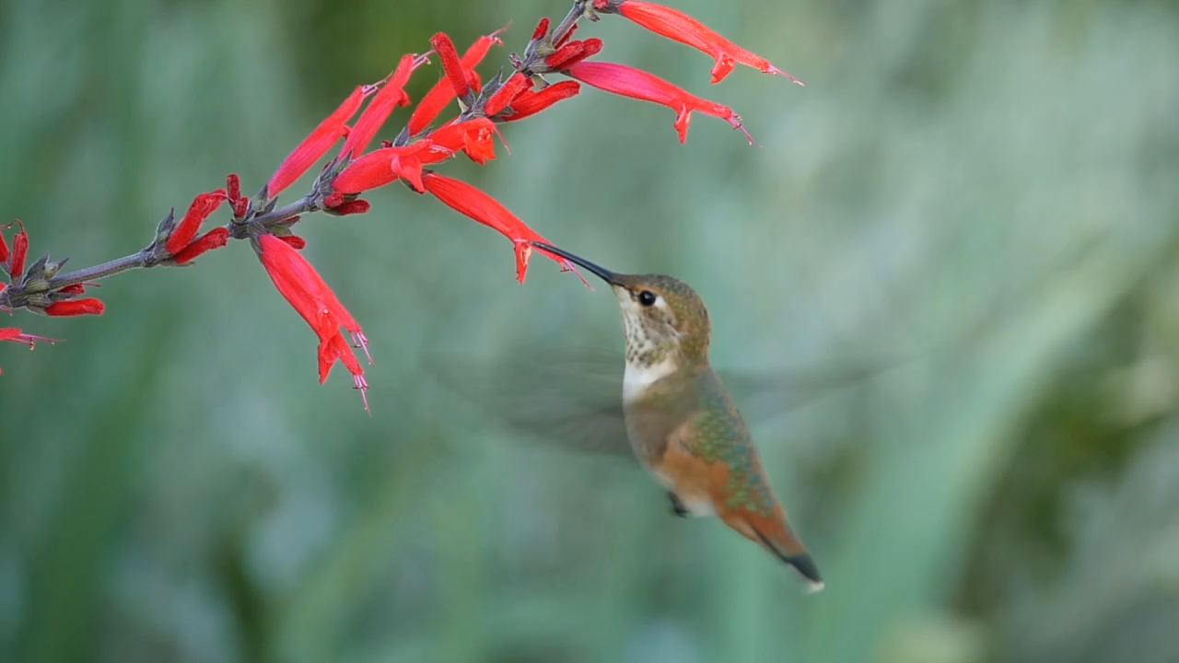
How do Birds Fly?
Not all birds fly in the same way. Turkey Vultures soar for hours without much wing movement, while hummingbirds, like the Allen’s Hummingbird in the video, flap their wings over 53 times a second as they fly forward, hover in place, and even fly backward.
Allen’s Hummingbird © Don DesJardin / Macaulay Library at the Cornell Lab (ML201782331)
Turkey Vulture © Eric Liner / Macaulay Library at the Cornell Lab (ML461976)
Notes:
[videos of turkey vulture and hummingbird]
Turkey vultures may soar for hours at a time. Other birds, like the wandering albatross – a very large seabird, may soar for months without landing, using the wind and air currents over the ocean to stay aloft.
Hummingbirds move quickly around the environment, darting from flower to flower
While there are some other birds that can hover, like harriers, kestrels, osprey, and kingfishers, there are no other types of birds that can fly backwards – only hummingbirds can do this.
[videos updated, need to update crediting]

Slide 4



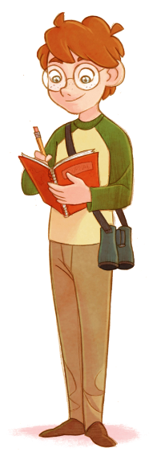
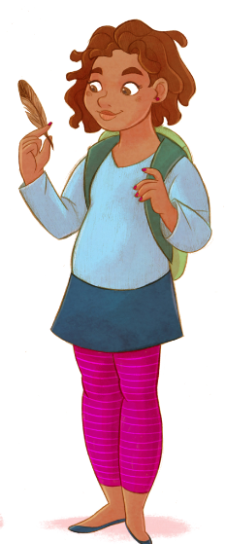
Try it!
Try to flap your “wings” like a hummingbird.
Now “soar” like a vulture.
How do these types of flight feel?
Image of kids: Anna Rettberg, Bartels Science Illustrator, Cornell Lab of Ornithology

Slide 5
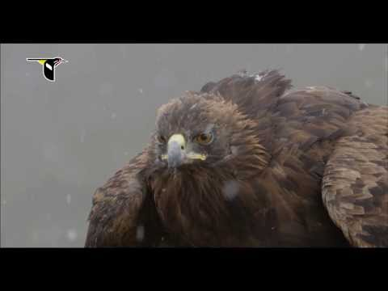
Bird Flight
Notice the way this Golden Eagle uses its legs and wings to take off.
How do its tail and wings help it fly and steer?

Slide 6
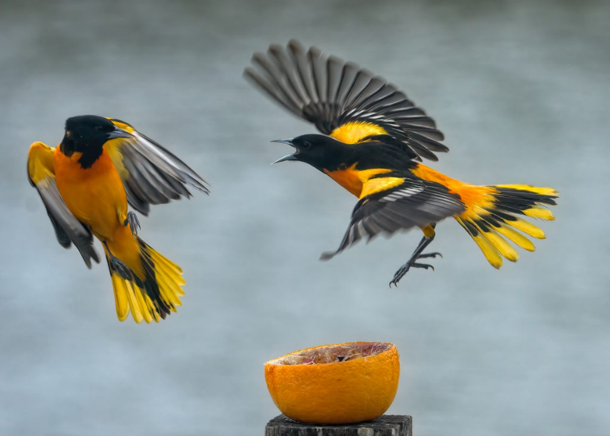
WHy Fly?
We know a bit about how birds fly, but WHY do they fly?
To escape predators
Find food
Establish a breeding territory
Find a mate
Migrate
Let’s explore migration and the dangers birds face on their extraordinary journeys.
Two male Baltimore Orioles fight over an orange.
Baltimore Oriole Sounds, All About Birds, Cornell Lab of Ornithology
© David Vonte, FeederWatch

Slide 7
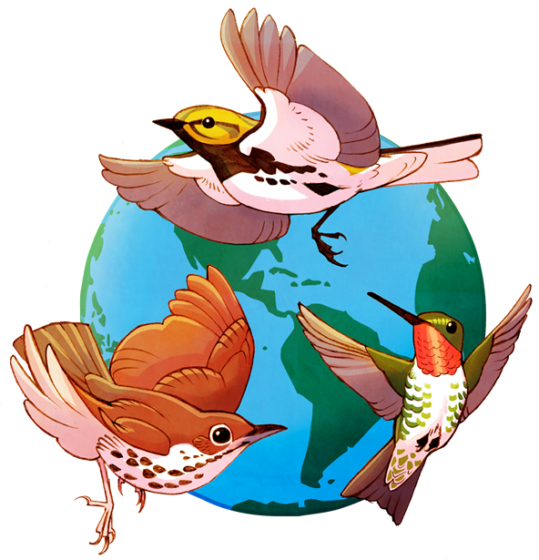
Migration
Flight allows some birds to migrate. Not all birds migrate, but many kinds of birds do.
Migration is the seasonal movement of animal populations between breeding (summer) and non-breeding (wintering) grounds.
Image: Anna Rettberg, Bartels Science Illustrator, Cornell Lab of Ornithology

Slide 8

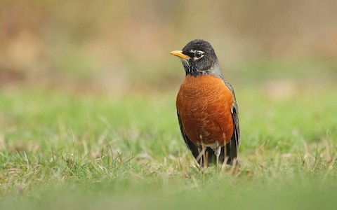
Migration Maps
Scientists at the Cornell Lab of Ornithology create models to show where and when birds move during the year. The American Robin does not move very much.
American Robin © Ryan Schain / Macaulay Library at the Cornell Lab (ML83264091)
Notes:
You might see more robins here in some parts of the year, but it’s quite possible to see robins in Massachusetts all year round.
[image updated, need to update crediting]

Slide 9
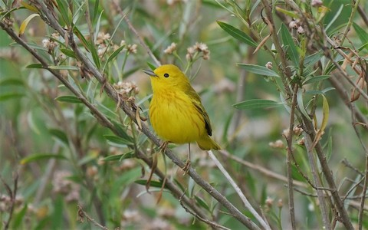
Migration Maps
The Yellow Warbler is a migratory bird. They spend the winter in Central and South America then travel up to North America to breed.
Yellow Warbler © Angela Kennt / Macaulay Library at the Cornell Lab (ML225721851)
Notes:
Yellow warblers are relatively long distance migrants – if you see a yellow warbler in Massachusetts during our winter, you know something went very wrong for that bird – it should be eating insects down in Mexico or Panama.
[image updated, need to update crediting]

Slide 10
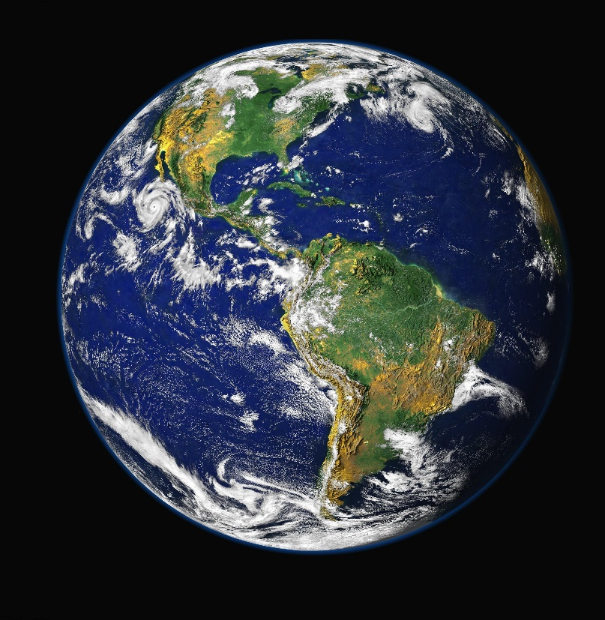
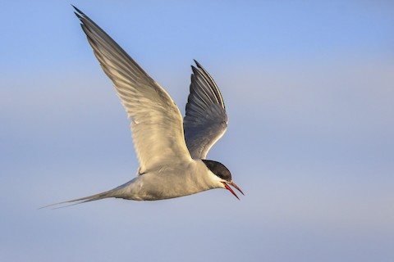
Amazing Migrations
Longest Migration: Arctic Tern
These birds fly more than 49,700 miles a year, making a round trip between their breeding grounds in the Arctic and their wintering grounds in Antarctica.
Image: Pixabay
© Matthew Pendleton / Macaulay Library at the Cornell Lab (ML66161701)
Notes:
Artic terns fly even further each spring and fall – traveling almost 50,000 miles each year as they travel from their breeding grounds in the Arctic to their non-breeding grounds in Antarctica.
[Imaged updated, need to update crediting]

Slide 11








Flight and Migration can be Hazardous!
Birds like these warblers and terns face many obstacles when they fly and migrate.
What hazards do you recognize?

Slide 12
Flight and Migration can be Hazardous!
windows and power lines
Birds face many obstacles when they fly and migrate.
Can you think of any other hazards?
cars
storms and bad weather
tall buildings
towers
Cats and other predators

Slide 13

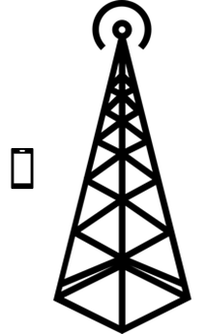

What Can People Do to Help?
Windows: Mark windows so birds don’t think it’s a space to fly into
Power lines: increase the space between power lines to prevent electrocution
Storms and bad weather: Put out bird houses & plant native plants for shelter
Towers: Change non-flashing lights to flashing & don’t use guidewires
Cars: Slow down, post warning signs, & build wildlife crossings & low fences
Cats and other predators: Keep cats indoors or on a leash
Cities and towns: Start a “Lights Out” program during migration

Slide 14
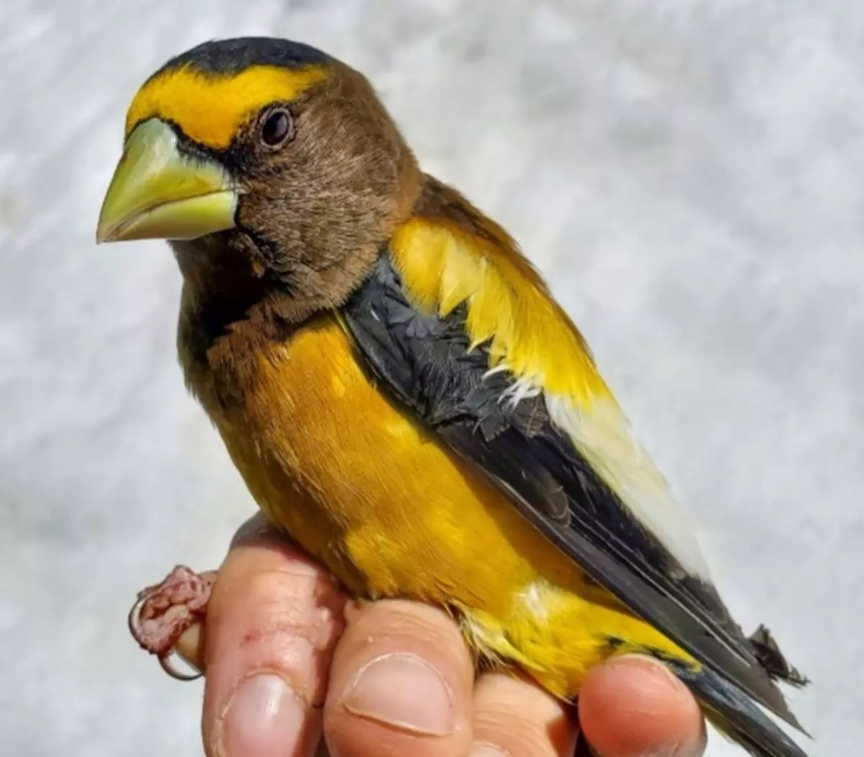
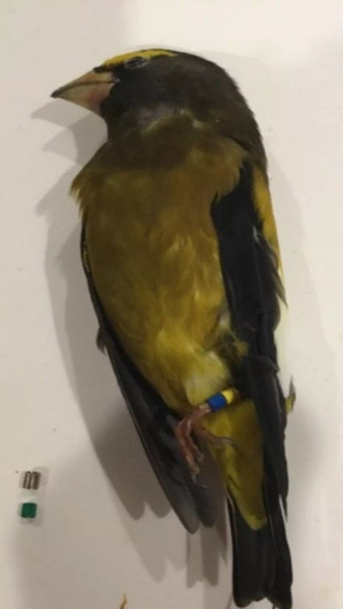
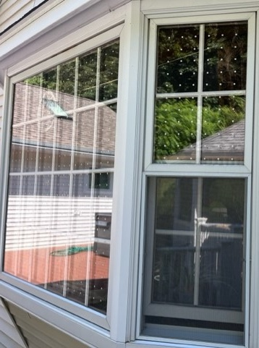
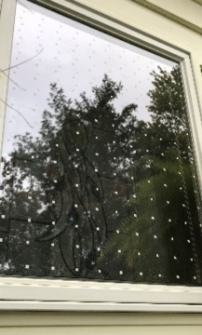
Saving 1 Billion Birds with Polka Dots and Stripes
Notes:
Birds don’t see glass – the see the reflection of the trees and sky on the windows, and sometimes they can see through windows to trees or sky on the other side, and they try to fly through with bad outcomes. Lights on buildings at night attract birds and increase the risk that the birds will collide with the buildings or glass.
Bird collisions are estimated to kill over a billion birds per year, which represents about 1 out of every 10 birds on the landscape in the spring.
This is an unsustainable loss for birds.
Often when people see one bird collide with a window they don’t realize that is happening at many houses, offices, and schools all over. When you start to add up one bird here and one bird there across all of the buildings in the US, we are losing a billion or more birds each year.
I want to share a story of a specific bird, Evening Grosbeak #228.
On April 4th, 2022, David Yeany, an avian ecologist with the Pennsylvania Natural Heritage Program, banded evening grosbeak number 228 and 17 flock mates in Aroostook County, Maine.
Bird bands are metal bracelets placed around the leg that have a unique number to identify the bird, and some birds like this one also get a unique combination of colored plastic bands so a research can identify an individual bird by looking at the colored bands with binoculars. Bird bands are like snow flakes – each band is unique so we can study individual birds.
As part of a larger project focused on conserving evening grosbeaks, David also attached a radio tag to 228.
The tiny radio tag is like a little backpack that pings radio towers and tells the researcher approximately where the bird is in the world.
Almost two months later, 228’s radio tag was heard near Cap Gaspe, Quebec, about 240 miles northeast of where he was banded. David believes 228 may have spent the nesting season near Cap Gaspe.
Six months later and 920 miles away in Grand Bend, Ontario, 228 was killed when he collided with a home window. Evening Grosbeak 228 was around a year and a half old.
Evening grosbeaks can live for at least 16 years, and #228 could have survived if the homeowner had known to take some simple actions to make their windows safe.
The photo on the right is a photo of a window at my friend’s house that was retrofit to make it bird safe – it has dots spaced two inches apart on the outside of the window – birds can see these dots and don’t get confused and fly into the window. And this other photo is a photo of my house where we also installed dots on the window after a catbird met an untimely end.
The good news is that all of these deaths are preventable with a few simple actions.
Image credits:
D. Yeary banded evening grosbeak.png, D. Yeany, Copyrighted, All Rights Reserved - Used by Permission, https://www.fws.gov/media/d-yeary-banded-evening-grosbeakpng
USGS BBL Web.png, USGS Bird Banding Lab/USGS Bird Banding Lab (BBL), Copyrighted, All Rights Reserved - Used by Permission, https://www.fws.gov/media/usgs-bbl-webpng
Bird-friendly window with dot pattern decal to prevent collisions, Joelle Gehring/USFWS, Public Domain, https://www.fws.gov/media/bird-friendly-window-dot-pattern-decal-prevent-collisions

Slide 15
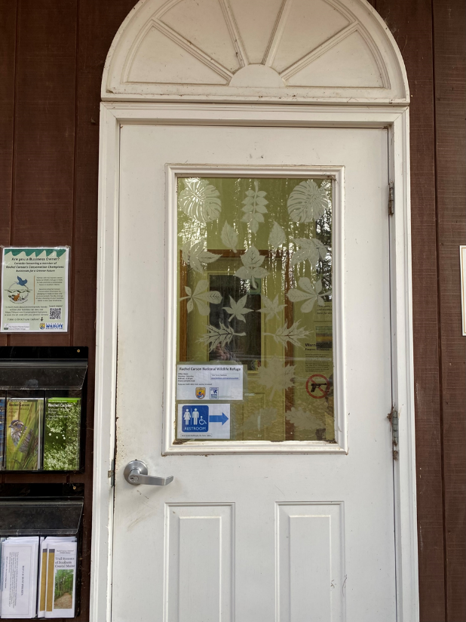
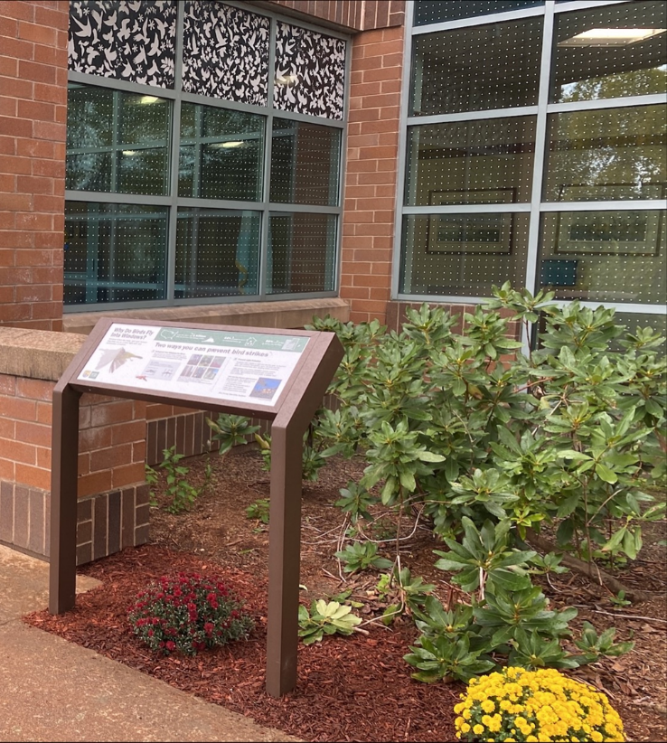
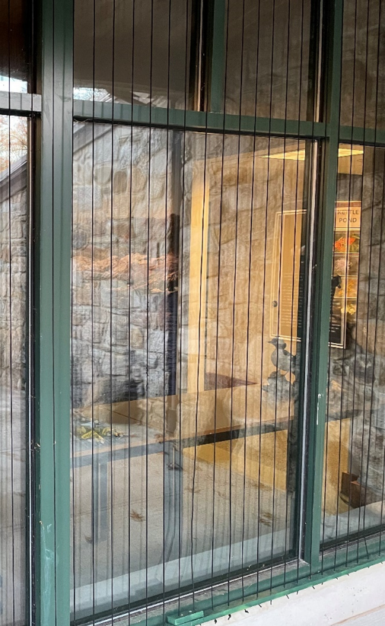
Turn Off the Lights, Mark the Windows
Notes:
A few things we can all do to save birds
- turn off lights at night when we don’t need them
- mark the window
Some examples of window markings are here – the first one is decals spaced 2 inches apart on the outside of the window,
the middle photo shows two products – one is a custom film with the birds at the top and the other is the dots spaced 2 inches apart – both are on the outside of the window, it also shows an interpretive sign – this tells visitors to the building why there are dots on the windows and encourages them to make their home windows safe for birds, and
the third shows acopian cords – these are nylon strings hanging on the outside of the window to break up the reflection.
All of these techniques can save birds.

Slide 16

Saving Birds, Having Fun
Today’s project:
  Design a presentation to encourage others to save birds!
  Pick a partner
  Pick a bird to tell the story
Future project:
  Make our windows visible to birds!
  Apply decals to the outside of windows
  Space them 2 inches apart

Slide 17
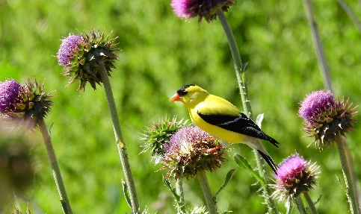
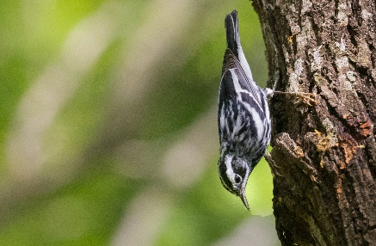
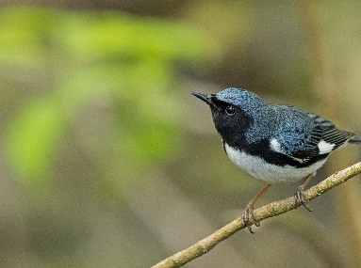
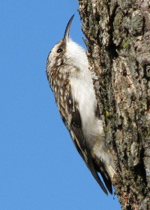
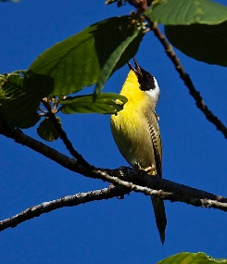
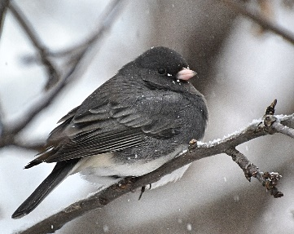
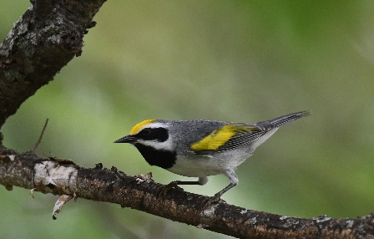
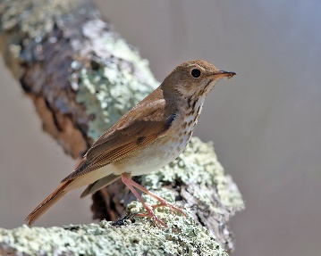
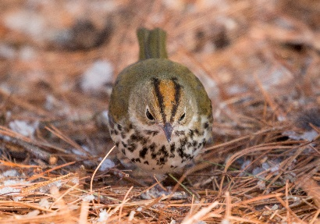
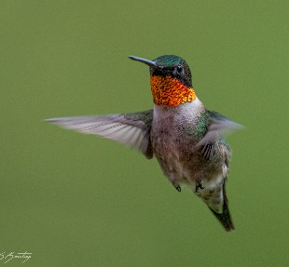
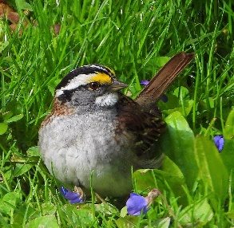
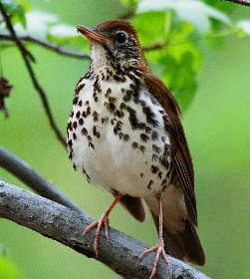
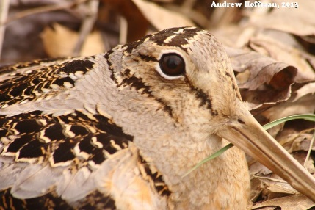
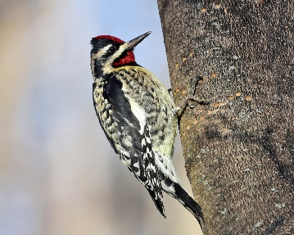
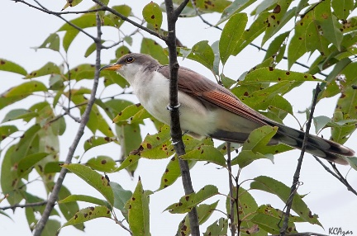
Bird that Often Collide with Windows and Towers
American goldfinch
Black-and-white warbler
Black-throated blue warbler
Brown Creeper
Common yellowthroat
Dark-eyed junco
Golden-winged warbler
Hermit thrush
Ovenbird
Ruby-throated hummingbird
White-throated sparrow
Wood thrush
Woodcock/ Timberdoodle
Yellow-bellied sapsucker
Yellow-billed cuckoo
Notes:
All photos are from flickr.com, all are creative commons license, can be shared with attribution for non-commercial purposes
American Goldfinch – Jim Mullhaupt – these birds like to eat thistle seeds from plants or your bird feeders, coming close to homes puts them at risk for collisions
Black and white warbler – Gregory Slobrdr Smith – these birds migrate to South America in the non-breeding season, and make a squeaky wheel sound in the spring
Black-throated blue warbler – Larry Hubble – these birds like to forage for insects on the underside of leaves in the forest
Brown creeper – Vicki DeLoach – these birds have a spine-tipped tail that helps them brace themselves to forage for insects on tree trunks
Common yellow-throat – Jerry McFarland – these birds like to live in marshy areas and make a “witchity-witchity” call
Dark-eyed junco – DaPuglet – these birds live in Massachusetts year-round and can be seen foraging on the ground and at feeders for seeds
Golden-winged warbler – Andy Reago and Chrissy McClarren – these birds breed in scrubby areas and their populations are declining quickly – they are “super-colliders” crashing into towers and windows more than you would expect based on their population
Hermit thrush – Tom Murray – these live in dense forests around here in the breeding season, more often seen than heard
Ovenbird – Tim Sackton – these birds wear an orange mohawk and nest in little leafy ovens they build on the forest floor
Ruby-throated hummingbird – Steven Kersting – these tiny birds arrive in April and come to my kitchen window to ask me to put the feeder out.
White-throated sparrow – Jo Zimny – these plump birds may appear at your bird feeders looking for seeds
Woodthrush – Billtacular – these pot-bellied thrushes are shaped like robins but have a reddish back, distinct spots on their breast and a clear call common in our woods in Massachusetts
Woodcock – Andrew Hoffman – Timberdoodles do a funny dance to woo their mates, and fly into buildngs way more often than you would expect. They arrive early in spring and you can hear them before sunrise peenting.
Yellow-bellied sapsucker – Tom Murray – these birds peck organized rows of bark off trees to harvest the sap and insects
Yellow-billed cuckoo – Kelly Colgan Azar – cuckoo birds are real, and they don’t see windows easily, in years with abundant food – caterpillers – cuckoos will raise their own chicks and lay eggs in the nests of other birds like robins and catbirds – making them an occasional brood parasite.
https://abcbirds.org/blog/frequent-colliders/
https://www.allaboutbirds.org/

Slide 18

Motivating Change - behavior.rare.org
Why people don’t do things:
It’s not possible
It’s not clear what they should do
It’s easier and safer not to do anything (risk aversion)
It’s annoying or inconvenient
They don’t get why they should do something
Why people will do things:
Other people are doing it
Fun, easy, has an impact
Impact of something bigger
It benefits me personally
Other people are doing it!

Slide 19
Extra Slides

Slide 20

Diagram of Window retrofit
2 inches
Notes:
Sizing is ¼ scale
Window panes are 20x13 inches
Decals are 2x3” to 3.5x6“

